Slide 1
制作分析中有用的数据 Making Your Data Useful for Analysis
Microsoft Reactor | 上海
#ReactorShanghai

Slide 2
Chia-Chi Chang 張家齊
CEO, iiNumbers

Slide 3


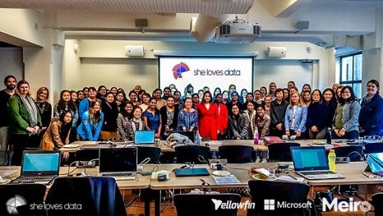

developer.microsoft.com/reactor/
@MSFTReactor on Twitter
Notes:
Welcome to your <location> Microsoft Reactors. We are worldwide local community spaces where developers and startup leaders meet, learn, and connect. Reactors build a diverse community by providing training, learning paths, industry speakers, and seminars, plus meetups and other community events related to emerging technology trends.
Reactor learning, networking, and leadership opportunities are designed to focus on real-world challenges to enable members of the tech community to stay up to date and drive solutions. Reactors are a place to share knowledge and expand impact in the company of technology enthusiasts locally and globally.
We have workshops and other learning opportunities planned throughout the year. Or if you want to host your own event at a Reactor, you can make the request on our website.

Slide 4
ML1 On-line Workshop Agenda ML1 在线研讨会议程
Day 1 第一天 |  | Day 2 第二天
19:30 | Welcome 开场 | 14:30 | Welcome 开场
19:35 | Machine Learning Pipeline for Real Problem 如何运用机器学习处理问题？ | 14:35 | How to Evaluate a Machine Learning Model? 如何评价一个机器学习模型？
19:55 | Dimension Reduction & PCA 降维方法与主成分分析 | 15:05 | Introduction to ROC Curve & Generalized Error ROC 曲线简介 & 模型误差衡量方式
20:25 | 5-min breaks 中场休息 | 15:25 | 5-min breaks 中场休息
20:30 | Advanced Topics in Dimension Reduction Part1 进阶降维方法：监督式降维与非线性降维 | 15:30 | Advanced Topics in Generalized Error & Objective Function 进阶模型误差衡量方式与目标函数
21:00 | Advanced Topics in Dimension Reduction Part 2 进阶降维方法：深度学习 | 16:00 | Advanced Topics in Generalized Error & Deep Learning 进阶模型误差衡量方式与深度学习
21:20 | Q&A 问答 | 16:20 | Q&A 问答
21:30 | Event End 课程结束 | 16:30 | Event End 课程结束
Notes:
19:30 Opening 開場 19:35 Supervised Learning and Classification: Regression 監督式學習與分類算法：回歸分析 為例 20:05 Regression ipynb LAB 回歸分析 實作 LAB 20:25 中場休息 5-min breaks 20:15 Introduction to Azure ML Studio Azure ML Studio 說明 20:30 Azure ML LAB Azure ML 實作 LAB 21:00 The Weakness of ML Models in Real World and How to overcome? 補充教材：機器學習在應用中的盲點與突破 21:20 Q&A 問答與補充 21:30 Event End 課程結束

Slide 5

Notes:
Data defines the world around us. The combination of mountains of data and computing that is both powerful enough and economical enough to make sense of that data has led to huge breakthroughs in science, medicine, and the consumer technologies that we now take for granted. But for all the advances that the data revolution has made, it is still held back by a resource shortage: people; specifically, people with technical skills in data science who can navigate this growing field and help explain discoveries in it to others.
For example, we might be able to:
- Assist doctors with detecting tumors on an MRI scan that might otherwise be too small to be noticed at first
- Help farmers increase their crop yields and use fewer resources like water and fertilizer
- Help a person who is blind identify people or obstacles in front of them
- Reduce defects in the manufacturing process
The video we watched shows the power and affordability of big data processing on cloud platforms like Azure. DNA sequencing analysis is a form of life-sciences research that has the potential to lead to a wide range of medical and pharmaceutical breakthroughs. However, this type of analysis requires supercomputing resources and big data storage, which many researchers have lacked before now. Working through a grant provided by the National Science Foundation in partnership with Microsoft, a team of computer scientists at Virginia Tech addressed this challenge by developing an on-demand, cloud-computing model using data & analytics services. By moving to an on-demand cloud computing model, researchers now have easier, more cost-effective access to DNA sequencing tools and resources, which could lead to even faster, more exciting advancements in medical research.
This workshop is about bridging the shortage of practitioners with technical skills in data, particularly in data science. Everyone should care about data science; you are here today because you are choosing to act to gain more information and skills in this vital, rapidly growing field. This course will give you a broad overview of many of the fundamental skills in data science using two of the most ubiquitous tools of the data trade: the Python programming language and the Jupyter Notebook interface. This course will give you a basic grounding in data science and some practical tools for performing it; these outcomes will provide you with the foundation from which to acquire deeper skills in this field, such as through the Microsoft certification for data science.

Slide 6
数据科学是什么？ What is Data Science?
领域專家
Domain Expertise
数据
科学
Data Science
编码技术 Coding skills
统计科学
Statistics
Notes:
Data Science is gaining momentum because of 3 advancements in computing:
Ubiquity of data; our devices and sensors are capable of creating terabytes worth of data every day
Access to nearly limitless compute power, available to anyone with an internet connection
Powerful algorithms that help us unlock more insight than ever from the data we have
(feel free to elaborate on the above with examples, hold up your phone or Apple Watch for example of consumer solutions)
Data science itself is not a new field. Statisticians just like to say that its statistics rebranded. Some say its statistics at scale for big data.
We would suggest that (modern) data science sits at the intersection of three primary skills:
It has a foundation in statistics with well-established math community and generally-accepted techniques like statistical significance and linear regression
Sophisticated data science requires people with coding experience to prepare data and build models that scale with accuracy
But often overlooked (and arguably most importantly), data requires domain expertise…to begin with research questions, to sport inaccuracies in the data set, to know what you’re looking for, to interpret the results, and communicate them
Anyone can contribute to data science – whether you’re a statistician, software engineer, business leader, or the foremost authority on butterfly migration patterns (natural scientist).

Slide 7
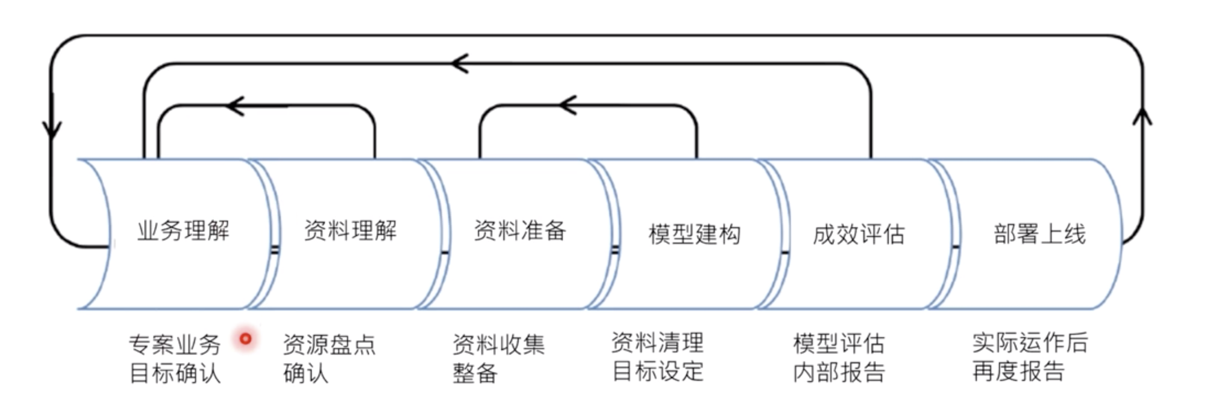
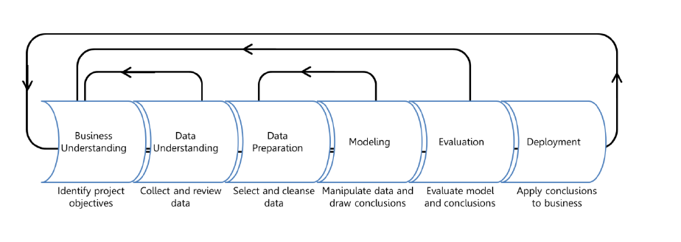
数据科学运作过程 Data Science Process
首要挑战，从巨量资料中挖掘有意义的线索
Extracting value from large amounts of data and making human sense of it is the primary challenge of data science.
Domain Expertise
Data
Science
Code/Computing Expertise
Math/Statistics
from Introduction to Data Science on Microsoft Learn: https://docs.microsoft.com/learn/modules/intro-to-data-science-in-azure/2-data-science-process
Helpful beginners' series: https://docs.microsoft.com/en-us/azure/machine-learning/studio/data-science-for-beginners-the-5-questions-data-science-answers
Notes:
So before we start experimenting with code and data science techniques, it’s important to begin with a conceptual understanding of how data science often works. We begin by…
Understand the business problem
In any problem-solving method the problem must first be identified. This can either be in the form of a question or a statement. There is always a general business understanding that will motivate the data science process in each situation.
In our example, your company understands they could be selling more brooms if they knew how many they could expect to sell each month, and stock their shelves accordingly.
Understand and prepare the data
Data understanding comes from the process of acquiring and exploring available data. This step involves obtaining and preparing the data to be used in model training. To train models, it's important to understand the data. Data scientists start by performing exploratory data analysis (EDA) to better understand the data they're working with, and identify which data elements drive the outcome they want to predict. With this understanding, can cleanse the data and extract the features required for modeling.
Your company gives their data to the data science team. The data engineer cleans and preps the data so that it's ready for the modeling process. EDA helps you learn about the relationship among data elements, which helps determine which data (or features) you will need to train the model. For example, it might help to know what people most frequently buy with brooms.
Model the data
The modeling step is a cycle of steps that occur to improve results. Modeling can consist of several techniques, but typically one cycle iteration is not enough to produce good results, so the cycle is repeated until the desired results are achieved.
You use the available data and move into modeling and feature engineering. For this type of question where there are many different numerical variables, you try a time series model and evaluate its performance.
Deployment
This step is usually left to the developers. It consists of integrating the solution into the business to solve the original problem. For your company, deployment would mean using the prediction of broom sales to properly stock the shelves.
Summary
Data science is a data-driven process that starts with a question. Data acquisition and understanding then drives the modeling. The steps a data scientist usually focuses on are data understanding and modeling, which is where the results are produced. After that, the developer implements the results to test the performance.

Slide 8
人工智能就是一切计算机尚无法做到的… “Artificial Intelligence is just whatever a computer can’t do yet…”
Chris Bishop, Microsoft Research
Notes:
Chris is probably somewhere in the building today. In fact, is he here?
The continuing moving of the goal post.

Slide 9
人工智能是指计算机在做人类智慧通常会思考到的事情
“Artificial Intelligence is computers doing things that we would normally think of as intelligent in humans.”
Rick Barazza, Microsoft DX
Notes:
Our working definition.
It’s not just doing things that humans do. That’s not very hard. Humans do all sorts of dumb things that much simpler animals do. So we’re setting the bar higher than that. But not crazy high. We’re saying, AI is about carving out more and more pieces of intelligent behavior. And so by that definition AI is here today, and has been for a while now.
Before we talk about how Artificial Intelligence works, let’s talk briefly about Natural Intelligence.

Slide 10
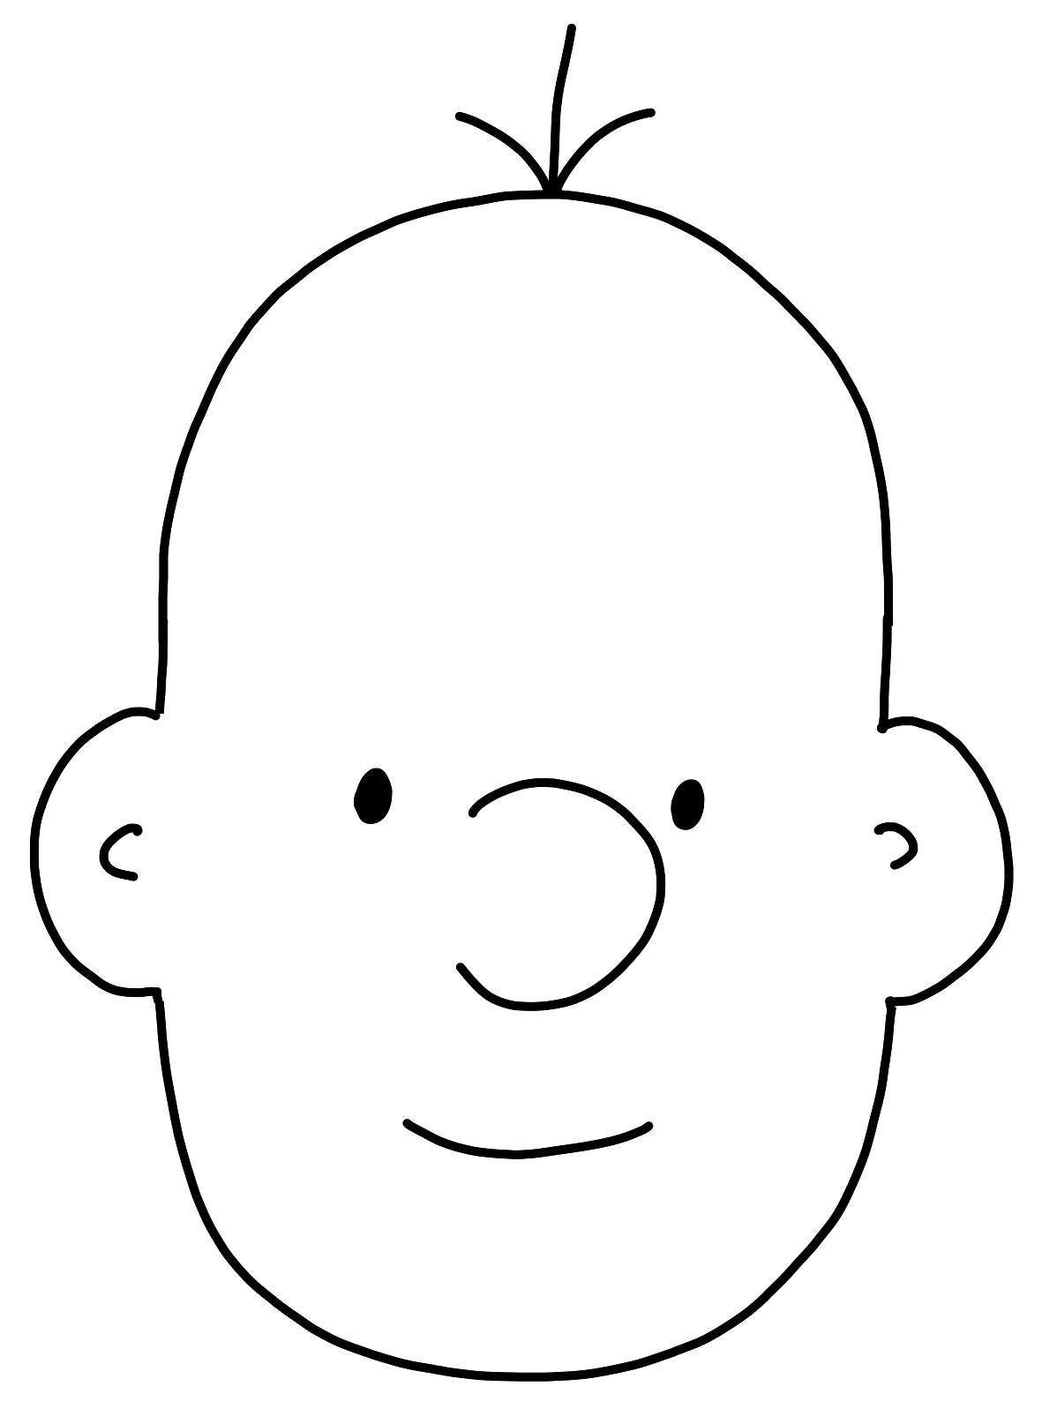
模型
Model
感官输入
Sensory Input
行为
Behavior
Notes:
I’m a dad. Who else here is a parent? Mine are teenagers now, and it’s trite to say it, but it seems like they were just babies yesterday. And it seems like just yesterday that I was a lot younger too, a hopelessly naïve new parent who thought that the job of a parent is to teach his children things. To explain the world to them. And actually I remember being stressed out because I didn’t know everything. How was I going to explain the world to my baby if I didn’t know everything? I literally started reading a lot more nonfiction.

Slide 11

模型
Model
数据
Data
答复
Answers
Notes:
The first time I showed this to Micheleen I asked her how she liked me drawing and she said, “it scared me.”

Slide 12
运算法则
Algorithms
病变？
Diseased?
Notes:
Start with a specific question: “Is this retinal scan of a diseased eye?”
Build the puzzle by necessity. Don’t mention something new (features) until you need it.
Built the puzzle
Talk about how you spend your time (calling out data wrangling as something that developers already do – “metadata scientist”)
Talk about math, how much you need, where you need it
Also a chance to talk about hidden bias in data, e.g. skew towards men in software. So an ML “should I hire this person” would weight men heavily. The data is not bad, it’s just reflecting a situation that is itself the result of bias. The way to subtract it is to extract it explicitly.
But this is also an opportunity! We can’t subtract bias from people’s brains, but we can subtract it from models. So that “hiring engine” may in the end be a force for social justice.

Slide 13
在这里工作，你不必懂数学...但懂的話会有帮助！
You don’t have to know math to work here… but it helps!

Slide 14
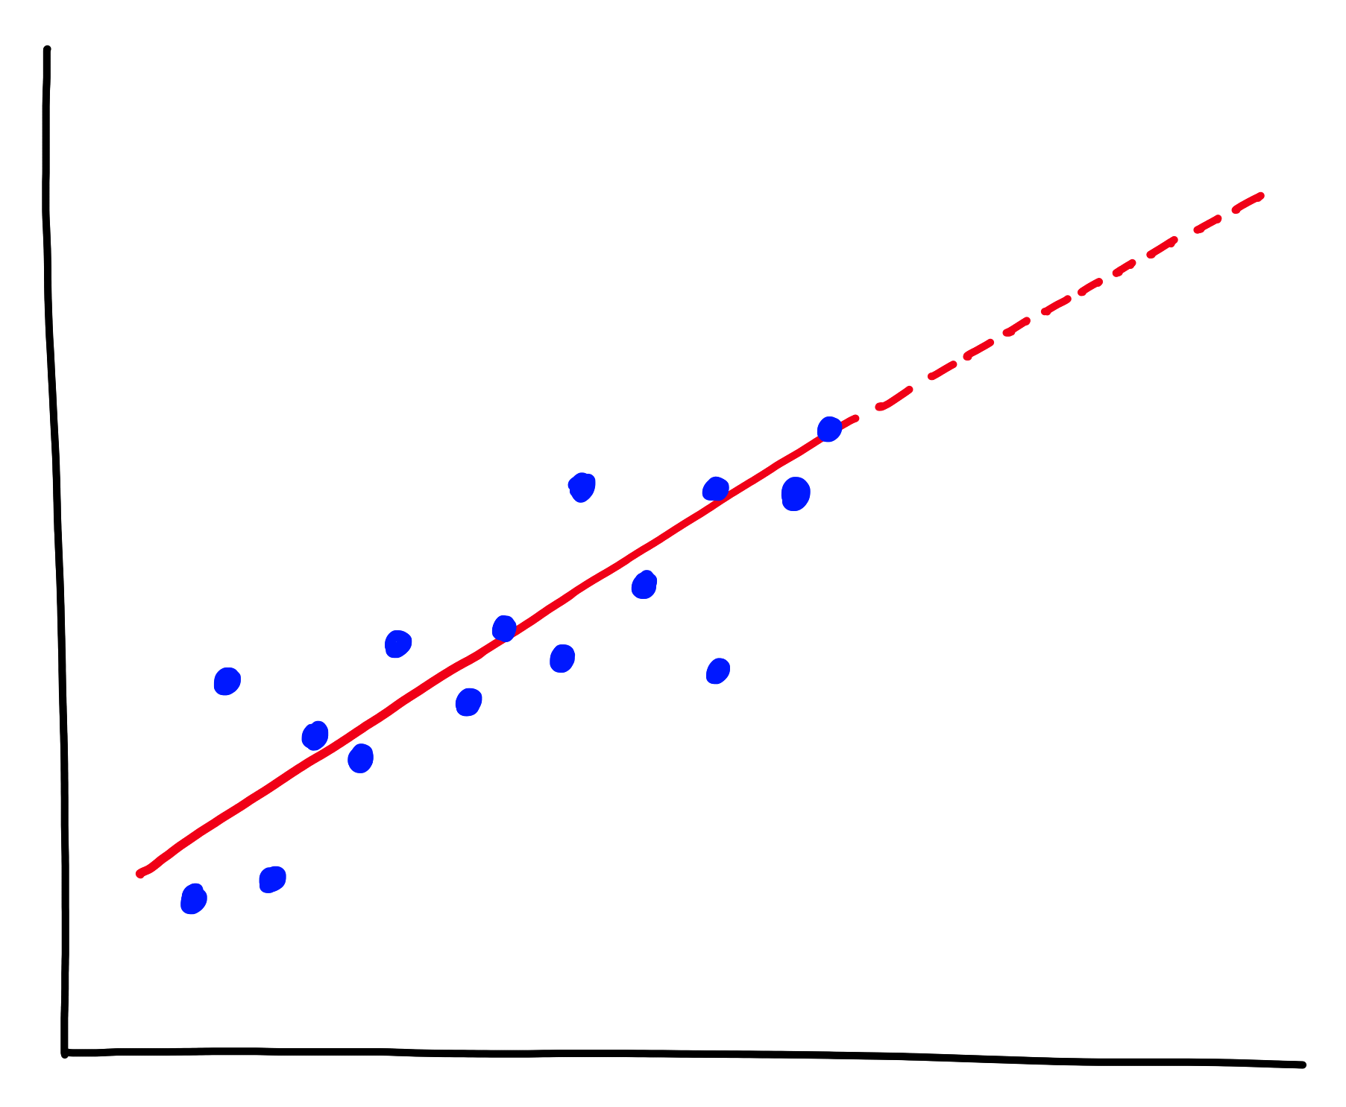
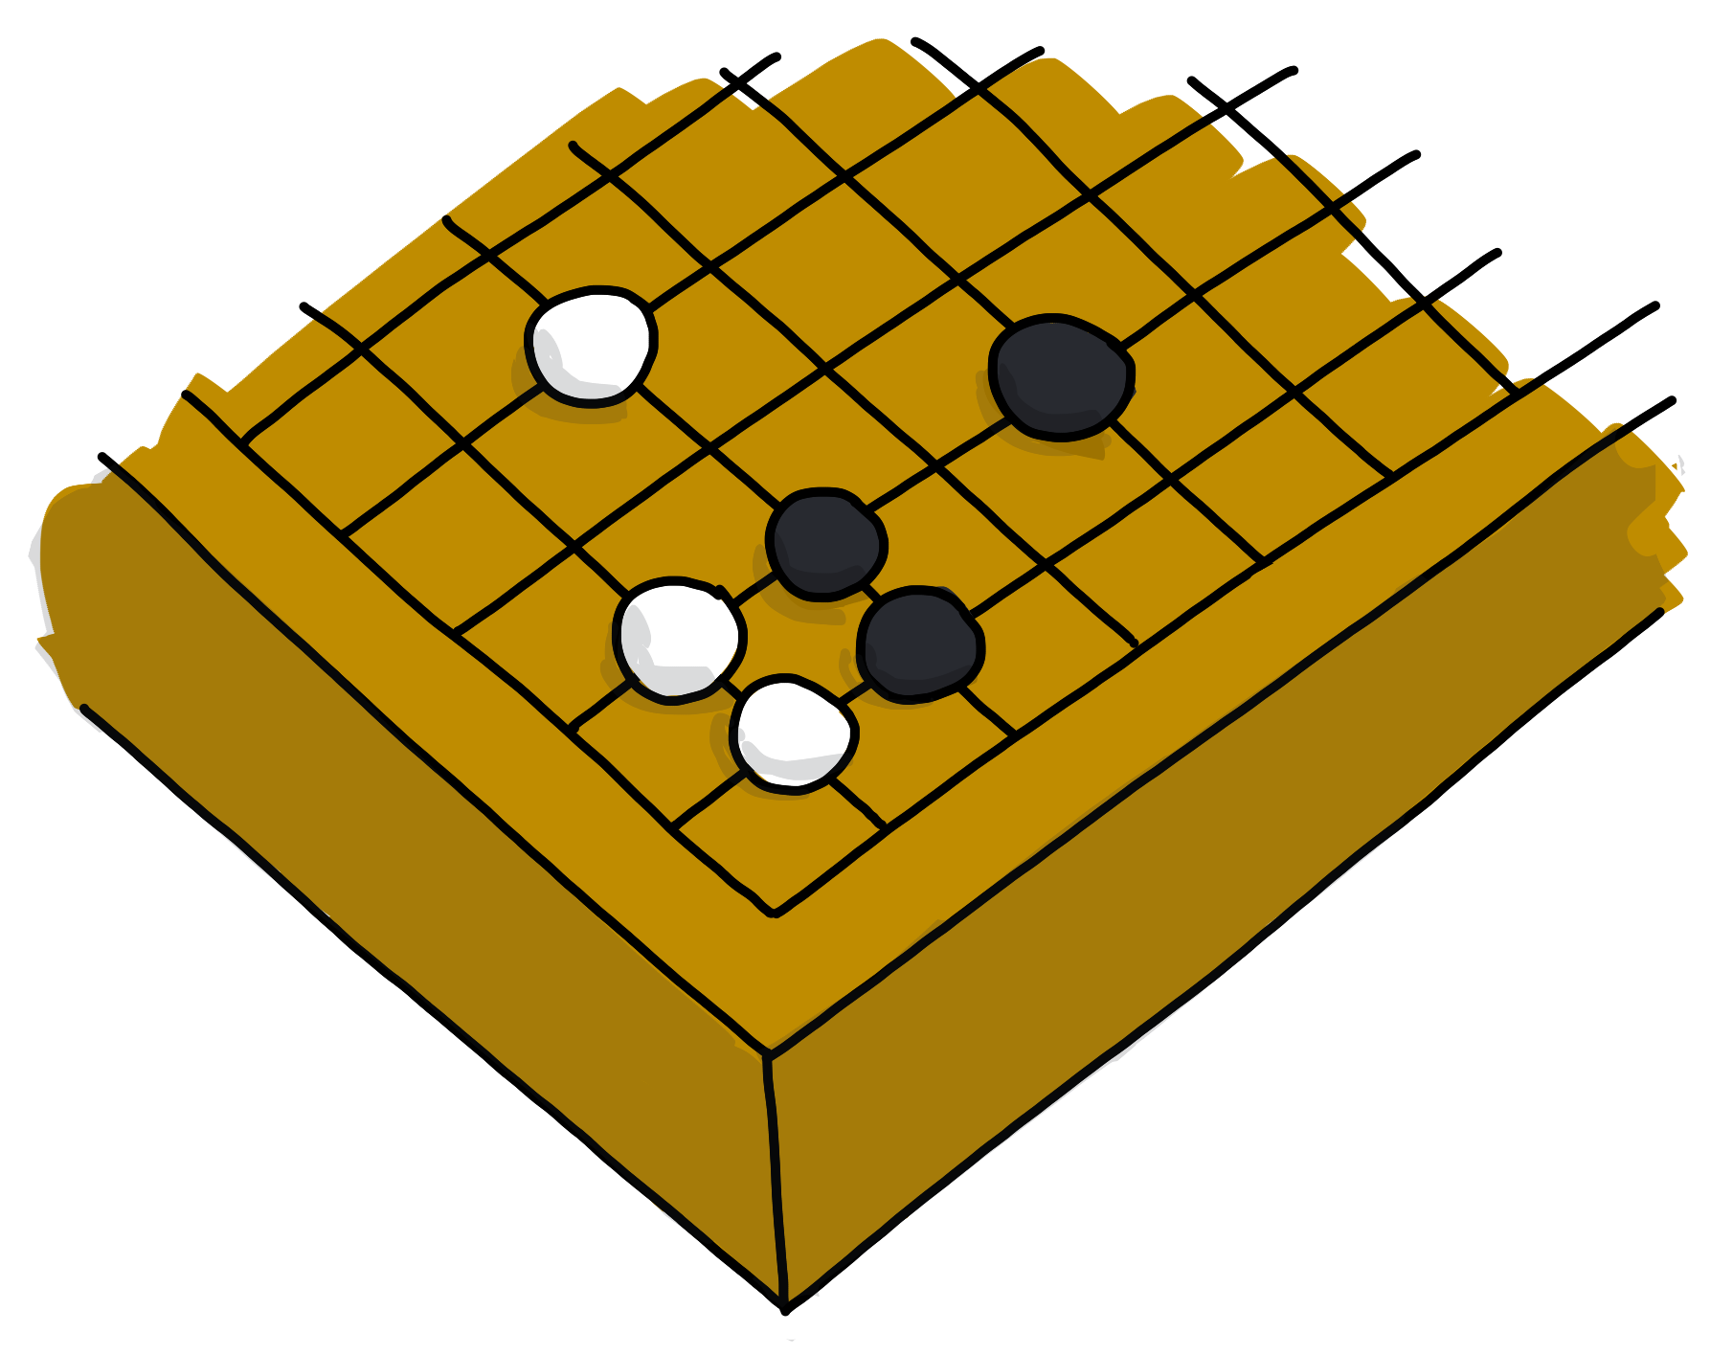
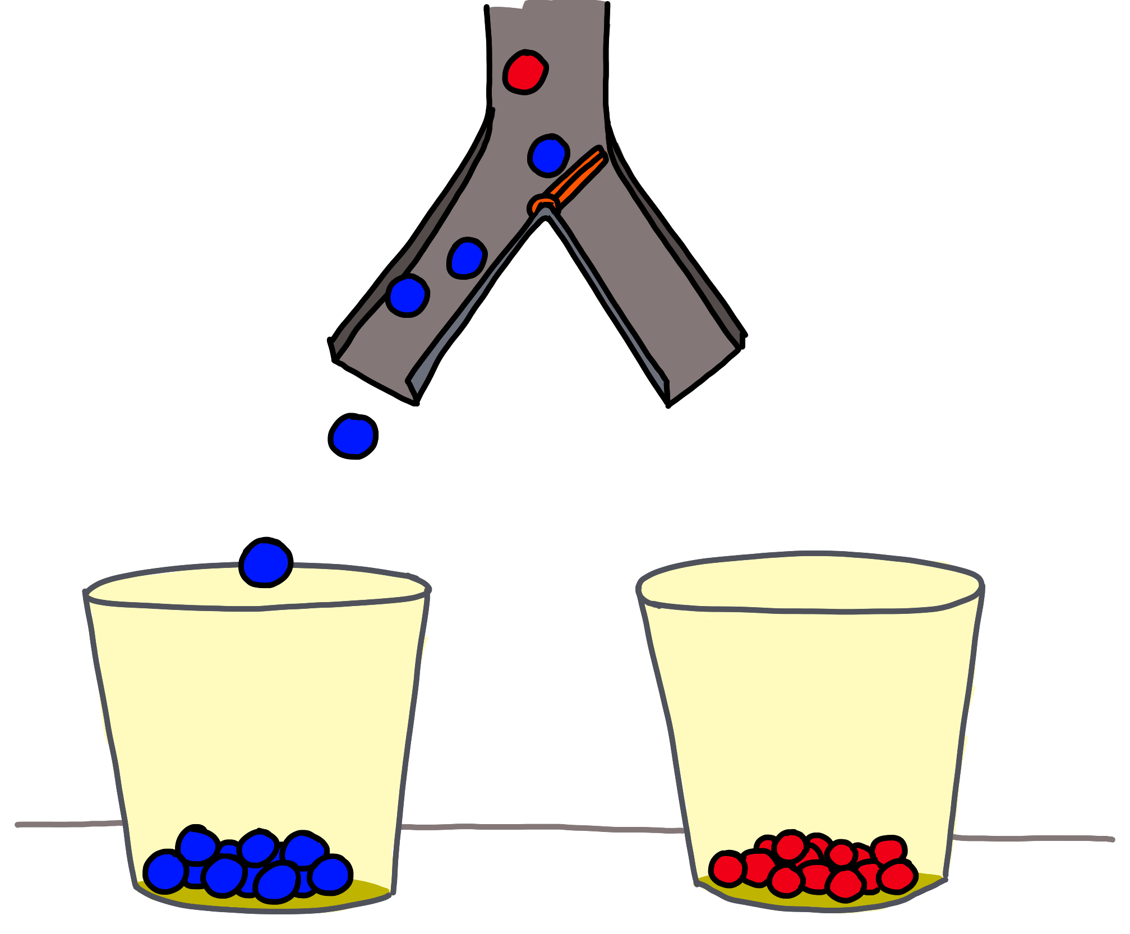
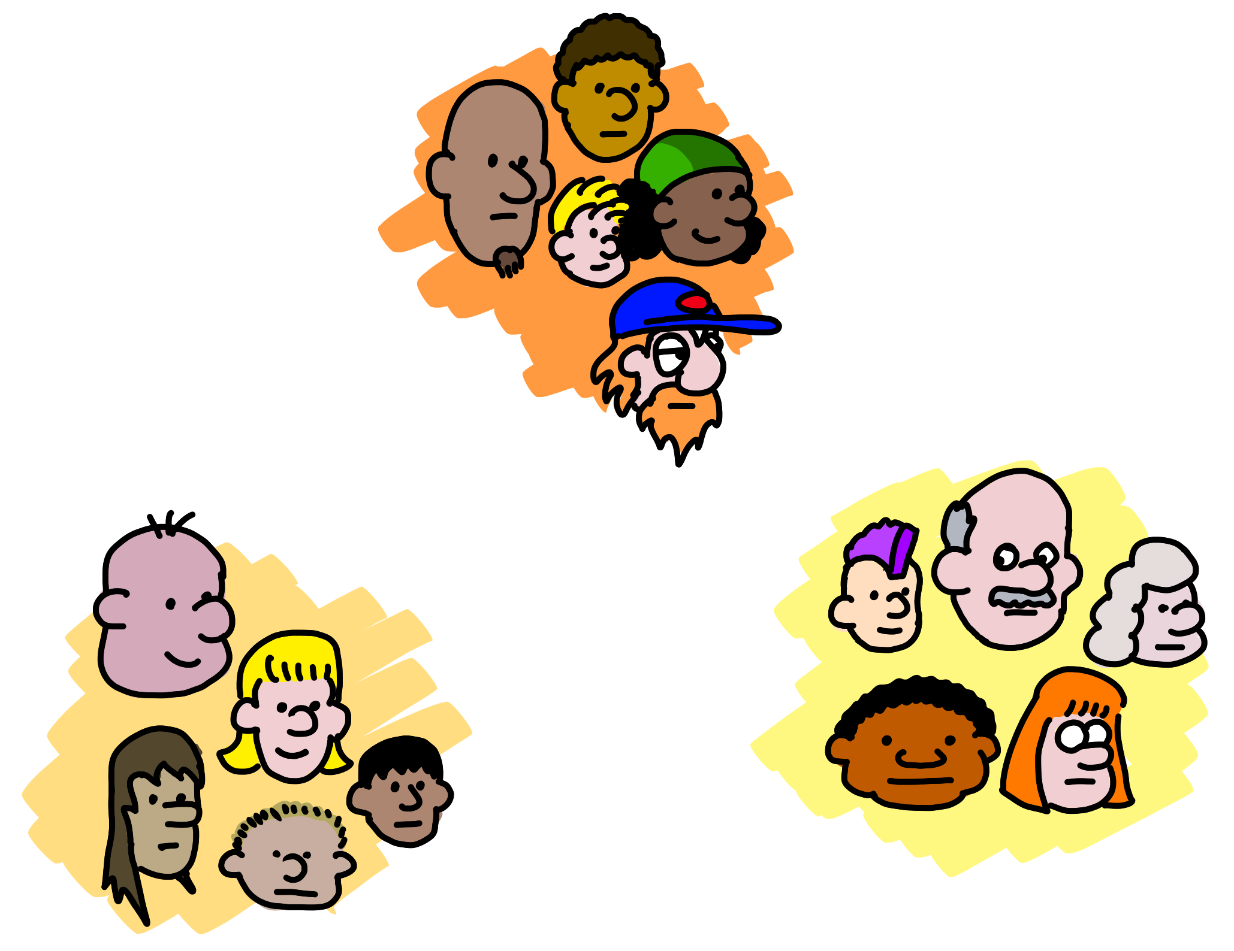

预测有多少
Predict how much/many
（回归）
(Regression)
接下来呢？
What next?
（强化学习）
(Reinforcement Learning)
哪个类别？ Which category?
（分类）(Classification)
怪异之處？ Is it weird?
（异常）
(Anomaly)
数据结构 Data structure
（聚类，推荐）
(Clustering,
Recommender)
5 questions courtesy Brandon Rohrer
Notes:
The five questions you can answer with traditional ML
Regression: Predict a real value for new data given trends in tagged example. How much/how many? e.g. Sea level rise: we are currently using data on sea level changes over the past century and the accelerating upward trend to estimate the amount of sea level rise in the coming century.
Anomaly: Identify when something unexpected happens. – Is this weird? E.g. Pacemaker hacking: research is being done to detect malware in a pacemaker in order to prevent data hijacking or malware-related malfunctioning by using an anomaly detector to pick up changes in data transmission timing to a cardiac log or even power consumption and electromagnetic radiation changes.
Reinforcement Learning: Take some appropriate action or next step E.g. Roomba or Roomba-competitor: a Roomba decides whether to return to the base or vacuum the living room again – there’s some sort of reward/penalty involved here.
Classification: Assign a category to each item or data point E.g. Exploring the night sky for planets: light curves (stellar brightness over time) of a unexamined stars with Kepler data are being classified as either having transiting planets or not using a pre-trained model on stars with and without transiting planets.
Clustering/Recommenders: Get to the structure or layout of data. Are there clearly separable groups? E.g. Hepatocellular carcinoma metastasis: researchers are looking at the differential profiles of proteins being expressed to find those that are upregulated during the cell invasion process in order to find new cancer treatment targets.
Also questions you can’t ask. Que

Slide 15
让我们从克隆工作坊笔记本开始 Let’s begin by cloning our workshop Notebook
https://notebooks.azure.com/geektrainer/projects/ml-1
如果您还没有 Microsoft 帐户， 请于此处申请 ：
If you don’t already have a Microsoft Account, start here:
account.microsoft.com

Slide 16
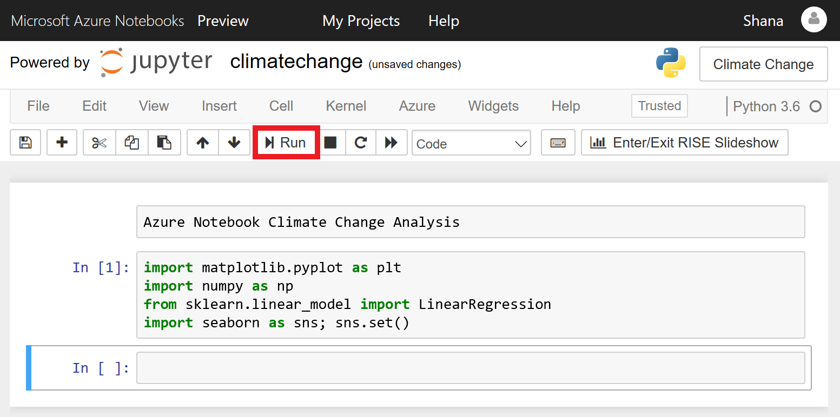
如何在 Azure 笔记本中导航 How to navigate Azure Notebooks
https://docs.microsoft.com/en-us/learn/modules/analyze-climate-data-with-azure-notebooks/1-create-an-azure-notebook
Notes:
Azure Notebooks is a cloud-based platform for building and running Jupyter notebooks. Jupyter is an environment based on IPython that facilitates interactive programming and data analysis using a variety of programming languages, including Python. Jupyter notebooks enjoy widespread use in research and academia for mathematical modeling, machine learning, statistical analysis, and for teaching and learning how to code.
Azure Notebooks provide Jupyter as a service for free. It's a convenient way to build notebooks and share them with others without having to install and manage a Jupyter server. And it's web-based, making it an ideal solution for collaborating online. In this lab, you will create an Azure Notebook and use three popular Python libraries — scikit-learn, NumPy, and Seaborn — to analyze your data. Then you will share the notebook so others can experiment with it, too.

Slide 17

合并数据集 Joining datasets
Notes:
As a general rule, data scientists assume that about 80 percent of the time and effort devoted to a project will be spent preparing data for analysis. Because most real-world data is split among multiple existing datasets, this invariably means cleaning and joining different datasets together in the way that a data scientist needs for analysis. Thus, mastering these skills is essential for undertaking data science.

Slide 18
第 1 节 概述
加载数据 探索和清洗数据 拆分数据框
合并数据框
Loading data
Exploring and cleaning data
Splitting DataFrames
Joining DataFrames

Slide 19
数据框 DataFrame
基本上是一个关系数据库
Basically a relational database table
特性和功能
Features and functionality
列具有名称 数据探索 执行合并和集合
清洗数据
Columns have names
Data exploration
Perform joins and unions
Cleanse data

Slide 20
数据加载 Loading data
pandas.read_csv() 是主要的工具
pandas.read_csv() is our primary tool
设置encoding参数来处理具特殊字符的文件
encoding parameter for files with special characters in them
Notes:
Because pandas DataFrames are two-dimensional data structures, they are inherently similar to flat-file formats such as comma-separated value (CSV) files, the most common import and export format for spreadsheets and databases. Adding to this ease of translation from CSV files to DataFrames, pandas provides a convenient function to load the contents of CSV files into DataFrames (more convenient, in fact, than the native Python CSV library). Let's get comfortable with the pandas.read_csv format because we will be using it often.
There are quite a few parameters for this function. The intuitively named encoding parameter accepts str input from the list of Python standard encodings. Although data-science practitioners do develop a familiarity with different encodings they have encountered, selecting the correct encoding can sometimes come down to trial and error.

Slide 21
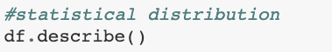
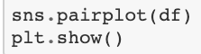
探索和清洗数据Exploring and cleaning data
Explore data. 探索数据
查看各列的统计属性
查看资料的关联性与模式
更容易探索相关性
得到各列的统计分布
See statistical properties of columns
See the connections / pattern in your data
Explore correlations more simply
Get statistical distribution of columns
Notes:
The DataFrame.info() method lets us know the data type of each column and how many values are in each column (which, in turn, tells us how many null values are in a column).
DataFrame.duplicated() provides a Boolean mask for duplicate values that we can then sum by using the Series.sum() method.
DataFrame.drop_duplicates lets us remove duplicate values from our DataFrame. The keep=“last” parameter instructs pandas to keep the last occurrence of duplicate values.

Slide 22
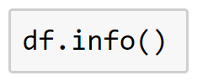
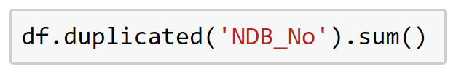
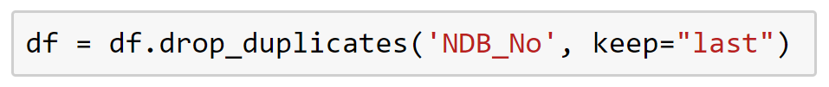
探索和清洗数据Exploring and cleaning data
检查数据类型和空值。Check data types and null values.
查找重复项。Evaluate duplicate entries.
删除重复项。Remove duplicates.
Notes:
The DataFrame.info() method lets us know the data type of each column and how many values are in each column (which, in turn, tells us how many null values are in a column).
DataFrame.duplicated() provides a Boolean mask for duplicate values that we can then sum by using the Series.sum() method.
DataFrame.drop_duplicates lets us remove duplicate values from our DataFrame. The keep=“last” parameter instructs pandas to keep the last occurrence of duplicate values.

Slide 23
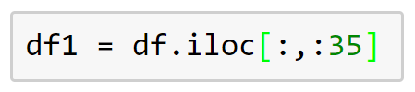
拆分数据框 Splitting DataFrames
DataFrame.iloc
使用索引操作数据框的行和列
manipulate DataFrame rows and columns by index number
行Rows
列Columns
Notes:
Splitting DataFrames usually involves creating smaller portions of existing DataFrames. The DataFrame.iloc() method is a powerful tool for this: by handling DataFrame content by row and column index number (rather than by name, for example), we have a means to programmatically manipulate the data to meet our needs.

Slide 24
Splitting DataFrames
DataFrame filters
子集 / 用过滤器对dataframe进行取样
Subset / sample a dataframe using filters
df.filter(“insert_condition”, axis=0) # 0 = row, 1 = column
更具弹性的过滤 / 取样 More flexible filters / samples
condition on column/field .series_id for each row
Notes:
Splitting DataFrames usually involves creating smaller portions of existing DataFrames. The DataFrame.iloc() method is a powerful tool for this: by handling DataFrame content by row and column index number (rather than by name, for example), we have a means to programmatically manipulate the data to meet our needs.
type
category
class (classification)
kind

Slide 25
合并数据框 Joining DataFrames
df1
ID | Name
1 | Sarah
2 | Christopher
3 | Susan
Inner join
双边必须匹配 Both sides must match
Pd.merge(df1, df2, how=‘inner’, on=‘ID’)
Outer join
保留原表所有的数据行Keep the side you "point to"
pd.merge(df1, df2, how='left', on='ID')
ID | Name | Locale
2 | Christopher | Seattle
3 | Susan | Ottawa
ID | Name | Locale
1 | Sarah | null
2 | Christopher | Seattle
3 | Susan | Ottawa
df2
ID | Locale
2 | Seattle
3 | Ottawa
4 | San Diego
Notes:
The type of dataset join that’s most widely used by practicing data scientists is the left join. If you already have some experience with SQL, you know what this refers to. Basically, a left join is a join that takes all of the data from one DataFrame (think of it as the left set in a Venn diagram) and merges it with everything that it has in common with another DataFrame (the intersection with the right set in the same Venn diagram).
We do this using the merge() function. We also need to specify the type of join we want to perform by using the how parameter, as well as specifying the index on which to join the DataFrames by using the on parameter.
Another intuitive and widely used type of join is the inner join. This join simply merges all entries that are common to both DataFrames, resulting in a DataFrame that has no NaN values.

Slide 26
连接 / 堆叠 DataFrames
Concat / stack DataFrames
ID | Name | Locale
1 | Sarah | null
2 | Christopher | Seattle
3 | Susan | Ottawa
df1
ID | Name
1 | Sarah
2 | Christopher
3 | Susan
连接 (垂直结合)
Concat (combine vertically)
并非双边都需吻合
Not both sides must match
pd.concat([df1, df2], columns=[“Name”, “Locale”])
其他参数
other variation:
axis: 0 = join row by row, 1 = join by column
join: inner / outer => 与之前提到的 join 相似
join: inner / outer => similar to join as mentioned before
df2
ID | Locale
2 | Seattle
3 | Ottawa
4 | San Diego
Notes:
The type of dataset join that’s most widely used by practicing data scientists is the left join. If you already have some experience with SQL, you know what this refers to. Basically, a left join is a join that takes all of the data from one DataFrame (think of it as the left set in a Venn diagram) and merges it with everything that it has in common with another DataFrame (the intersection with the right set in the same Venn diagram).
We do this using the merge() function. We also need to specify the type of join we want to perform by using the how parameter, as well as specifying the index on which to join the DataFrames by using the on parameter.
Another intuitive and widely used type of join is the inner join. This join simply merges all entries that are common to both DataFrames, resulting in a DataFrame that has no NaN values.

Slide 27
Groupby
Groupby (Split -> Apply -> Combine)
并非双边都需吻合
Not both sides must match
group = df.groupby(“column”).agg(“min”)
切分你指定的数据至不同组
This splits the data based-on the data you specified into groups
接着你可以将函数应用在各组上，例如：mean(), max() 或是某些更复杂的函数 lambda function
Then you can apply a function (i.e. mean(), max() or something more complex i.e lambda function) on the groups
你可以在结合而成的dataframe，基于各组呼叫分析函数或查看结果
You can then see the analytic function or result based on each group in a combined dataframe
我们待会就能从code中查看范例
We will see examples soon in the code
Notes:
The type of dataset join that’s most widely used by practicing data scientists is the left join. If you already have some experience with SQL, you know what this refers to. Basically, a left join is a join that takes all of the data from one DataFrame (think of it as the left set in a Venn diagram) and merges it with everything that it has in common with another DataFrame (the intersection with the right set in the same Venn diagram).
We do this using the merge() function. We also need to specify the type of join we want to perform by using the how parameter, as well as specifying the index on which to join the DataFrames by using the on parameter.
Another intuitive and widely used type of join is the inner join. This join simply merges all entries that are common to both DataFrames, resulting in a DataFrame that has no NaN values.

Slide 28
Apply：在你的dataframe运行自定函数
Apply: Run custom functions on your data frame.
lambda函数：小型的临时函数，可有多个输入，但仅有一个输出或表达式
lambda functions: small ad-hoc functions, multiple inputs but 1 output / express
df.apply(lambda x: x+10) => 加10到每个dataframe的格子
df.apply(lambda x: x+10) => adds 10 to each cell in dataframe
df.col_name.appl(str)y => 将“col_name” 的值转为字串
df.col_name.apply(str) => turns values in “col_name” to string
axis: 0 = column, 1 = row
预定义函数：你也可以应用一个预定义的函数
predefined function: you can also apply a predefined function. i.e:
def sum_rows(arr):
return sum(arr)
df[sum_of_rows] = df.apply(sum_rows, axis=1)
=> 运用 “sum_rows”以新增列 ‘sum_of_rows’
=> adds new column ‘sum_of_rows’ with “sum_rows”
Notes:
The type of dataset join that’s most widely used by practicing data scientists is the left join. If you already have some experience with SQL, you know what this refers to. Basically, a left join is a join that takes all of the data from one DataFrame (think of it as the left set in a Venn diagram) and merges it with everything that it has in common with another DataFrame (the intersection with the right set in the same Venn diagram).
We do this using the merge() function. We also need to specify the type of join we want to perform by using the how parameter, as well as specifying the index on which to join the DataFrames by using the on parameter.
Another intuitive and widely used type of join is the inner join. This join simply merges all entries that are common to both DataFrames, resulting in a DataFrame that has no NaN values.

Slide 29
主成分分析 Principal component analysis
Notes:
One of the iron laws of data science is known as the “curse of dimensionality”: as the number of considered features (dimensions) of a feature space increases, the number of data configurations can grow exponentially. Thus, the number of observations (data points) needed to account for these configurations must also increase. Because this fact of life has huge ramifications for the time, computational effort, and memory required, it is often desirable to reduce the number of dimensions we have to work with.
One way to accomplish this is by reducing the number of features considered in an analysis. After all, not all features are created equal, and some yield more insight for a given analysis than others. Although this type of feature engineering is necessary in any data science project, we can really only take it so far; up to a point, considering more features can often increase the accuracy of a classifier. (For example, consider how many features could increase the accuracy of classifying images as cats or dogs.)
Another way to reduce the number of dimensions that we have to work with is by projecting our feature space into a lower dimensional space. The reason why we can do this is that in most real-world problems, data points are not spread uniformly across all dimensions. Some features might be near constant, whereas others are highly correlated, which means that those data points lie close to a lower-dimensional subspace.

Slide 30
第 1.2 节 概述
主成分分析 理论
PCA 与数据集
PCA实作
Principal component analysis (PCA) in theory
PCA and our dataset
PCA in practice

Slide 31
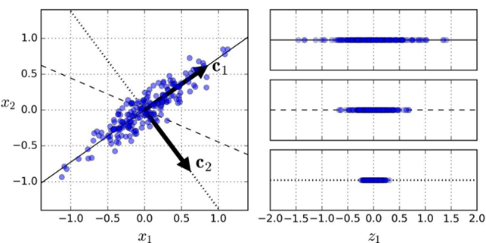
主成分分析 理论 PCA in theory
PCA可以在任意维度中找到数据的主轴（成分）
PCA finds the principal axes (components) of our data in arbitrary dimensions.
找到承载最多信息的成分后，我们可以将数据映射到一个子空间中，这些成分由新维度构成。
After we find the components that carry the most information, we can project our data into a subspace in which those components are the new dimensions.
Notes:
In the image on this slide, the data points are not spread across the entire plane, but are nicely clumped, roughly in an oval. Because the cluster (or, indeed, any cluster) is roughly elliptical, it can be mathematically described by two values: its major (long) axis and its minor (short) axis. These axes form the principal components of the cluster.
In fact, we can construct a whole new feature space around this cluster, defined by two eigenvectors (the vectors that define the linear transformation to this new feature space), $c_{1}$ and $c_{2}$. Better still, we don't have to consider all of the dimensions of this new space. Intuitively, we can see that most of the points lie on or close to the line that runs through $c_{1}$. So, if we project the cluster down from two dimensions to that single dimension, we capture most of the information about this data sense, while simplifying our analysis. This ability to extract most of the information from a dataset by considering only a fraction of its definitive eigenvectors forms the heart of principal component analysis (PCA).

Slide 32
PCA 与数据集 PCA and our dataset
从美国农业部国家营养标准参考数据库取得之数据
Data drawn form the U.S. Department of Agriculture National Nutrient Database for Standard Reference
在1.1节准备好的数据
有必须处理的空值
也有无法用於PCA中的类別数据
需标准化及中心化数值数据
删除高度相关的列
Prepared in Section 1.1
Has null values that must be dealt with
Also has categorical data that doesn’t work in PCA
Numeric data needs to be normalized and centered
Must also remove closely correlated columns

Slide 33
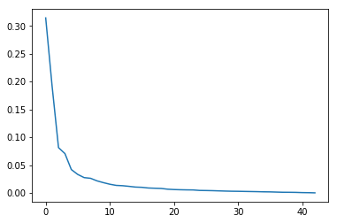
PCA实作 PCA in practice
应该要用多少成分？How many components to use?
碎石图中亦可看出，五个成分(components)就承载了大部分的信息
Scree graph also indicates that five components carry majority of info
Notes:
So, now that we have performed the PCA on our data, what do we actually have? Remember that PCA is first and foremost about finding the eigenvectors for our data. We then want to select some subset of those vectors to form the lower-dimensional subspace in which to analyze our data.
Not all of the eigenvectors are created equal. Just a few of them will account for the majority of the variance in the data. (Put another way, a subspace composed of just a few of the eigenvectors will retain the majority of the information from our data.) We want to focus on those vectors.
To help us get a sense of how many vectors we should use, a scree graph of the variance for the PCA components (like the one on this slide) plots the variance explained by the components from greatest to least. Looking for the “elbow” in the graph indicates where the returns (in terms of additional information from more components) begin to diminish.

Slide 34
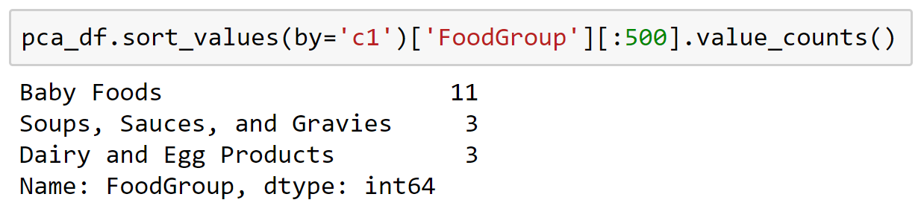
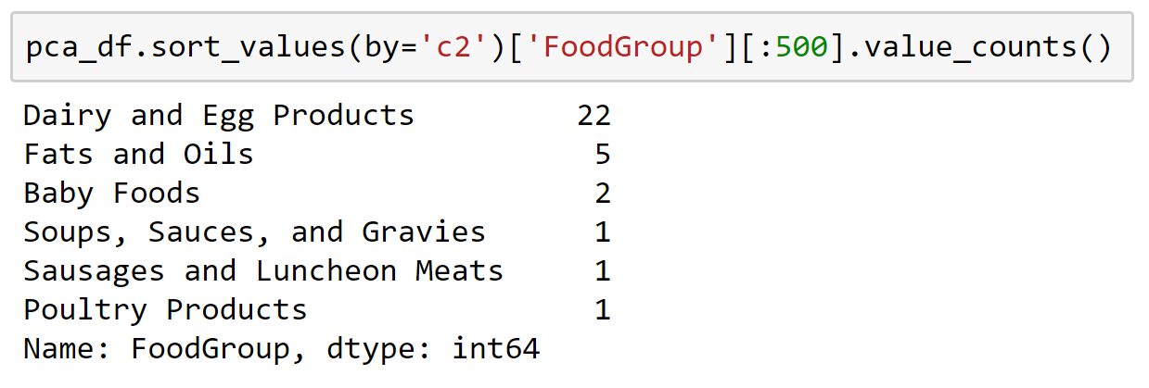
PCA实作 PCA in practice
解释
Interpretation
主成分与某些食物为主的向量相符
The principal components correspond with vectors predominated by certain kinds of foods
c₁
c₂
Notes:
Even without subject matter expertise, is it possible to get a more accurate sense of the kinds of foods that are defined by each component? Yes! We will put the FoodGroup column back into pca_df that we will create in the course of the section. Sorting that DataFrame by the components and counting the values from FoodGroup for the top items will show us which kinds of food predominate the various components.

Slide 35
https://aka.ms/ReactorFeedback

Slide 36
机器学习的准确率与接收者操作特征曲线(ROC曲线) Machine learning accuracy and the receiver operating characteristic (ROC) curve
Notes:
Just how accurate is a machine-learning (ML) model? The question might seem trivial at first: just look at the percentage of predictions or classifications that it gets right. But examining only the accuracy score of an ML model tells only part of the story of its usefulness in the real world.
All models produce false positives and false negatives; which of those should you tune your model to favor? If your model is to be used to identify individuals carrying an infectious disease, fewer false negatives at the cost of more false positives could be desirable. If you are making classifications in support of criminal cases, accepting more false negatives to avoid false positives might be essential.

Slide 37
第 1.3 节 概述
拟合模型
检验准度的方法
接收者操作特征曲线(ROC)曲线
Fit the model
Ways of assessing accuracy
Receiver operating characteristic (ROC) curve

Slide 38
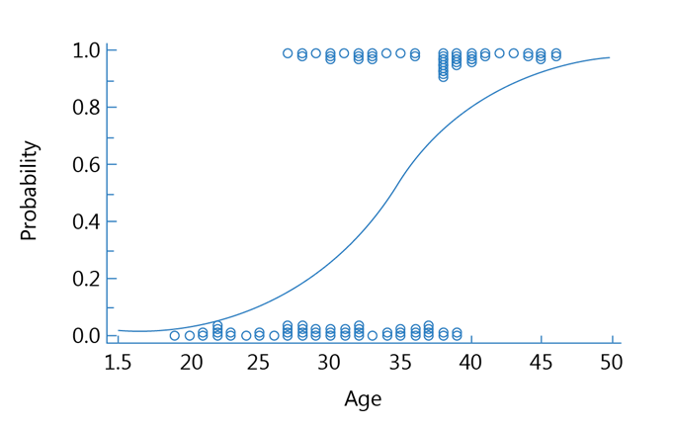
拟合模型 Fit the model
应用逻辑回归
Uses logistic regression
在0（false）和1（true）之间拟合一条S曲线
Fits an S-curve between 0 (false) and 1 (true)
模型会预测食物是否为低热量
Model predicts whether a food is low calorie or not
Notes:
We need a model whose accuracy we can examine. We will use a logistic regression model to predict low-calorie foods. Several foods appear to be very low in calories, so much so that the mean of Energ_Kcal is close to its 25th-percentile level, almost a full quartile away from where we might expect it, closer to its median value. As a result, Energ_Kcal should provide good results for prediction that will illustrate points about ML accuracy that we want to explore.

Slide 39
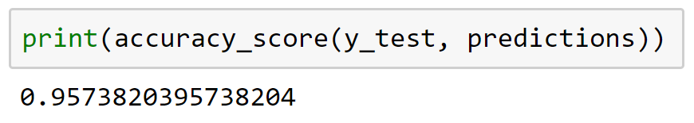
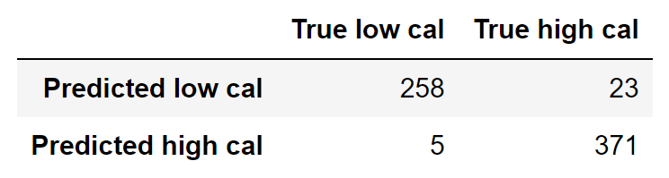
检验准度的方法 Ways of assessing accuracy
准确率 Accuracy score
混淆矩阵 Confusion matrix
Notes:
Why so many ways of measuring accuracy for a model? Recall from the beginning of the section that success means different things in different contexts. In some cases, avoiding false negatives is paramount (such as when working with infectious diseases). In other cases, avoiding false positives is essential (such as in instances involving the criminal justice system). Other times, striking a balance between false positives and false negatives is the best approach. These different measures provided the tools for data scientists to best tune their models for the problems at hand.
Accuracy score
Our accuracy score tells us the fraction of correctly classified samples: the sum of the number of correct true and false predictions divided by the number of all predictions.
Confusion matrix
The confusion matrix is another way to present this same information, this time with raw scores. The columns show the true condition, with positive on the left and negative on the right. The rows show predicted conditions, with positive on the top and negative on the bottom. So, the matrix below shows that our model correctly predicted 258 low-calorie foods (true positives) and incorrectly predicted another 23 foods (false positives). On the other hand, our model correctly predicted 371 higher-calorie foods (true negatives) and incorrectly predicted 5 more foods (false negatives).

Slide 40
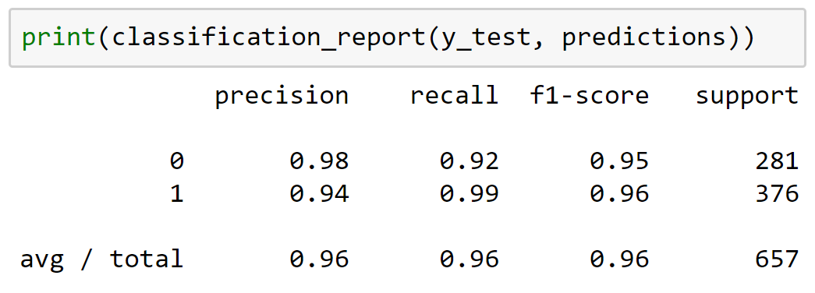
检验准度的方法 Ways of assessing accuracy
分类报告
Classification report
精确率 – 真阳性总数 / (真阳性总数+伪阳性总数)
召回率 – 真阳率（真阳性总数 / (真阳性总数+伪阴性总数)）
F1值 – 精确率与召回率的调和平均数
Support – 每一个标签的实例数
Precision—Number of true positives divided by the sum of true positives and false positives
Recall—True-positive rate
F1 score—Harmonic mean of precision and recall
Support—Number of true instances of each label
Notes:
The classification reports the proportions of low-calorie and high-calorie foods with four scores:
Precision: The number of true positives divided by the sum of true positives and false positives; closer to 1 is better.
Recall: The true-positive rate, which is the number of true positives divided by the sum of the true positives and the false negatives.
F1 score: The harmonic mean (the average for rates) of precision and recall.
Support: The number of true instances for each label.

Slide 41
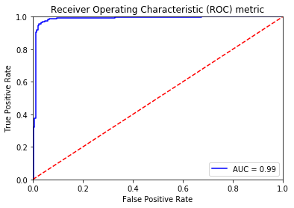
ROC曲线 The ROC curve
Notes:
The ROC curve was developed during World War II to measure the ability of radar-receiver operators to correctly identify aircraft, hence the name “receiver operating characteristic.” From military application, the ROC curve made its way more broadly to signal-detection theory and from there to statistics and data science.
ROC curves typically plot the true positive rate on the Y axis and the false positive rate on the X axis. This means that the upper-left corner of the plot is the “ideal” point: a false positive rate of 0 (zero), and a true positive rate of 1. Such an ideal is rarely (if ever) realized in practice, but it is the theoretical goal.
A key concept with ROC curves is area under the curve (AUC), with a larger AUC representing a better model. The slope of the ROC curve is also important because it’s better to maximize the true positive rate while minimizing the false positive rate.
Our model has an AUC of 0.99, which is higher than our accuracy rate of 0.96. Not only is our model accurate, but it achieves high rates of true positive classifications with very low rates of false positive classifications.

Slide 42
进阶学习：机器学习和数据科学 Further Learning in Machine Learning and Data Science…
微软在云沙箱免费学习资源：
此研讨会内容的复习小伙伴 ： docs.microsoft.com/learn/paths/intro-to-ml-with-python/
更多关于数据科学方法和最佳习题的信息： docs.microsoft.com/learn/paths/explore-data-science-tools-in-azure/
開始构建 ML 模型： docs.microsoft.com/learn/paths/build-ai-solutions-with-azure-ml-service/
数据科学虚拟机实验： docs.microsoft.com/learn/paths/get-started-with-azure-dsvm/
了解更多Azure的功能： docs.microsoft.com/learn/paths/azure-fundamentals/

Slide 43

基于角色的微软证书：
在数据科学领域：
Azure 数据工程师副学士
Azure 数据科学家副学士
Azure 开发 人员副学士
此外…
Azure 基礎認證
Azure AI 工程师副学士

Slide 44
developer.microsoft.com/reactor/
@MSFTReactor on Twitter
Notes:
Thank you!

Slide 45
© 2019 Microsoft Corporation. All rights reserved. The text in this document is available under the Creative Commons Attribution 3.0 License, additional terms may apply. All other content contained in this document (including, without limitation, trademarks, logos, images, etc.) are not included within the Creative Commons license grant. This document does not provide you with any legal rights to any intellectual property in any Microsoft product. You may copy and use this document for your internal, reference purposes.
This document is provided "as-is." Information and views expressed in this document, including URL and other Internet Web site references, may change without notice. You bear the risk of using it. Some examples are for illustration only and are fictitious. No real association is intended or inferred. Microsoft makes no warranties, express or implied, with respect to the information provided here.

